Slide 1

A Comparative Study of Machine Learning
Techniques for Cyber-Physical Attack Detection
Sergio Elizalde, Samia Choueiri
College of Engineering and Computing, University of South Carolina
ITEC 590 - Topic: Applied AI and Machine Learning for Cybersecurity

Slide 2
Introduction and Motivation
Operational Technology (OT) networks connect sensors, PLCs, and control systems.
Cyber-attacks propagate quickly and disrupt physical processes.
Detection must be fast and reliable.

Slide 3
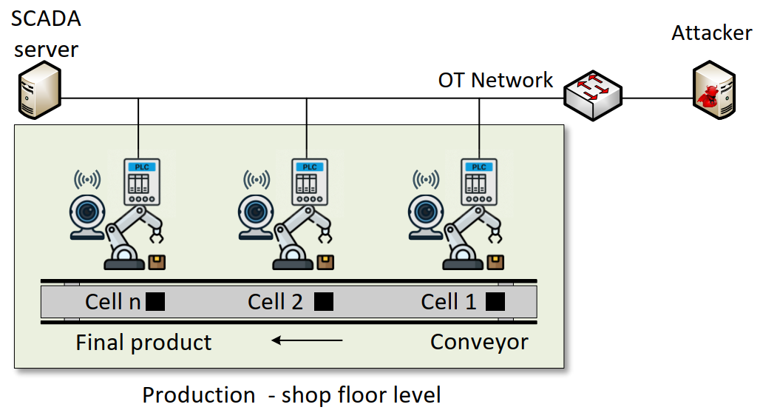
Background on CPS Attacks
PLC-controlled industrial cells connected to a SCADA.
CPS systems are exposed to various attacks, including denial-of-service (DoS), false data injection, replay attacks, and command manipulation targeting control processes.

Slide 4
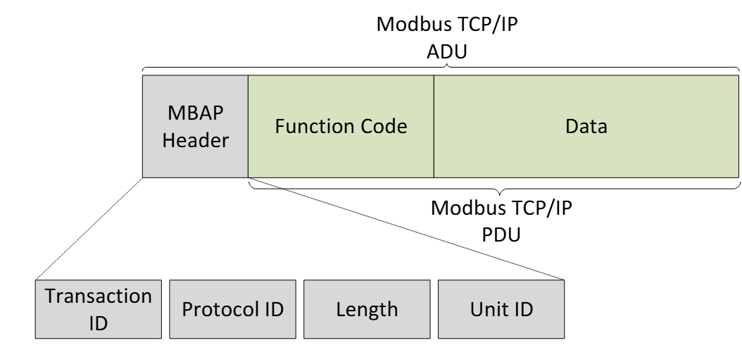
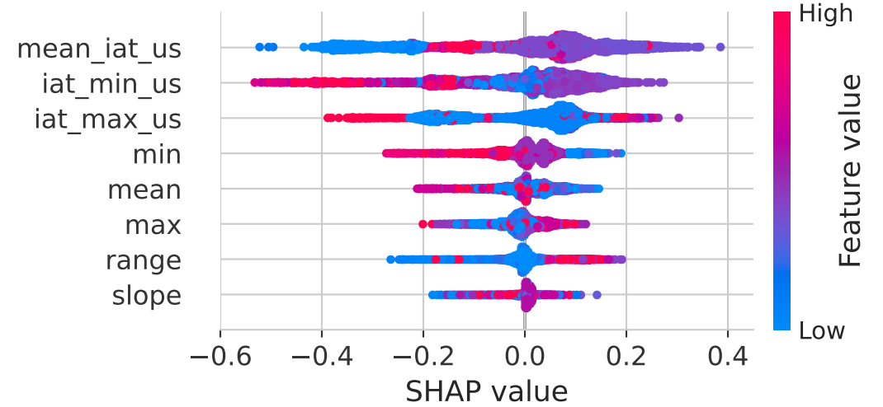
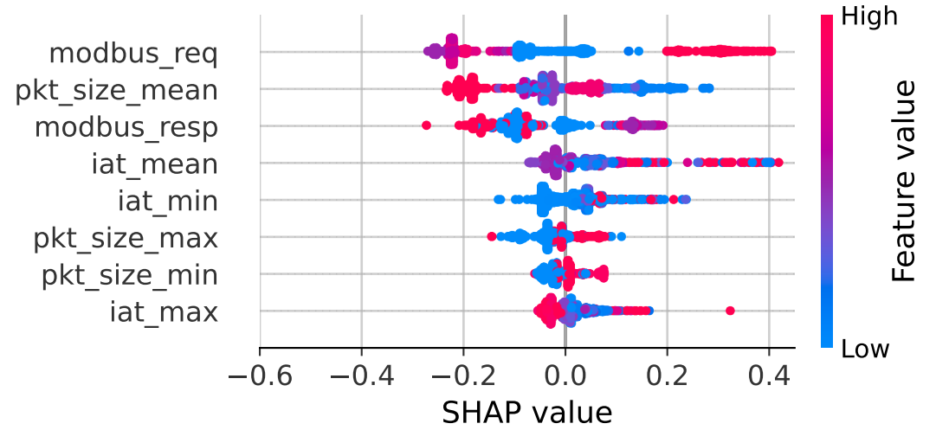
Feature Explainability
SHAP analysis reveals key feature contributions for attack detection.
Modbus Packet Header Fields
Modbus packets flow features

Slide 5
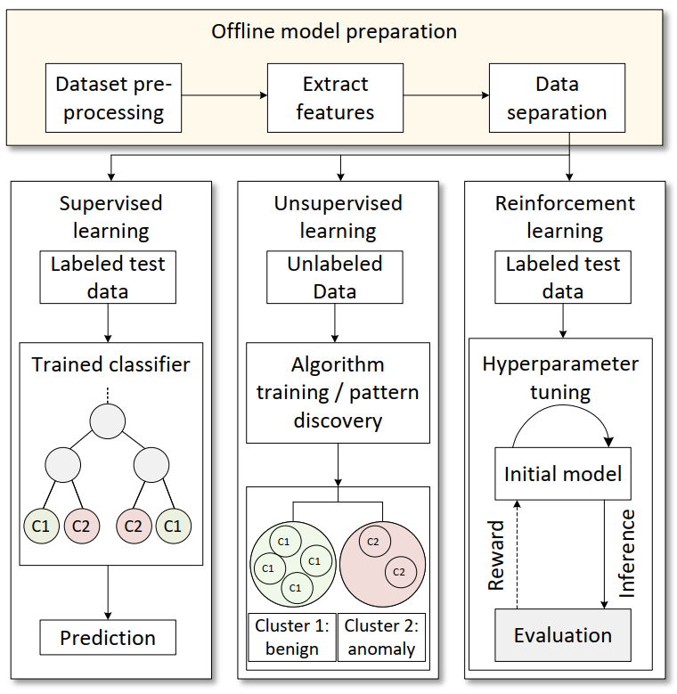
Methodology
Datasets:
Two CPS datasets: Zenodo ICS (testbed) and DataSense (IIoT lab).
Two-stage pipeline:
Offline feature extraction
Model training, followed by evaluation.
Extract flow-level features from Modbus/CPS network traffic.
Compare three approaches:
Supervised learning
Unsupervised learning
Reinforcement learning

Slide 6
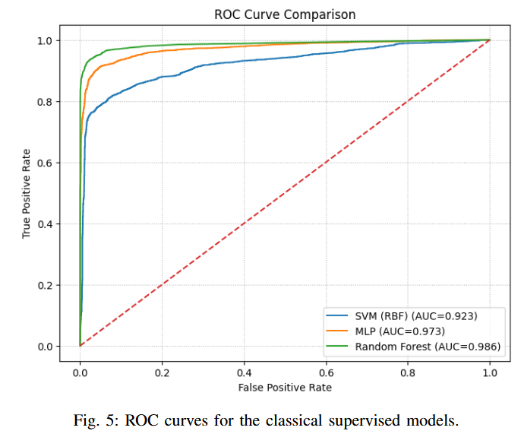
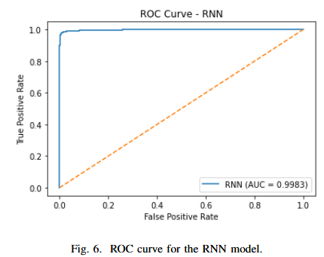
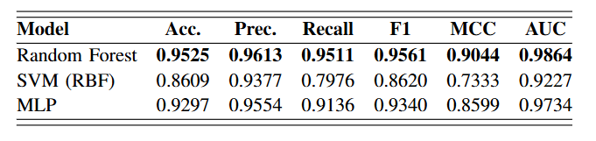
Supervised Learning
Evaluated Random Forest (RF), SVM, MLP, and RNN.
Random Forest achieves the best performance among classical models across all metrics.
MLP performs competitively, while SVM shows lower recall on complex patterns.
RNN further improves performance by capturing temporal dependencies in traffic sequences.
Notes:
RF 400 estimators, MLP 64,32 and SVM radial basis function
RNN
ACC 98%, PREC 98.9, Recall 98.5, MCC 97% and AUC 99

Slide 7
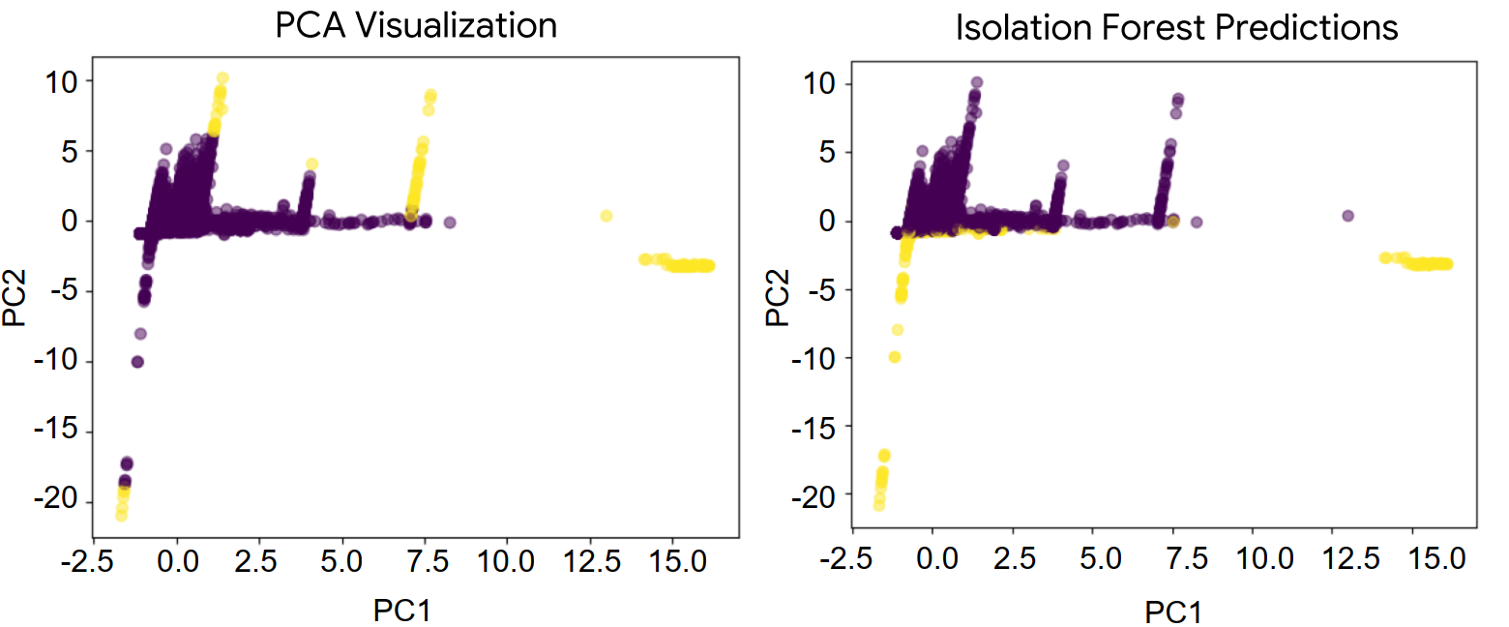
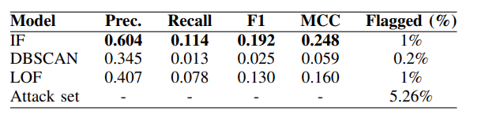
Unsupervised Learning
Overall performance is significantly lower than supervised models, especially in recall.
Isolation Forest performs best among unsupervised methods, but still misses many attacks.
Difficulty arises because attack traffic overlaps with normal behavior in feature space.
Highlights limitations of purely anomaly-based detection in realistic CPS environments.

Slide 8
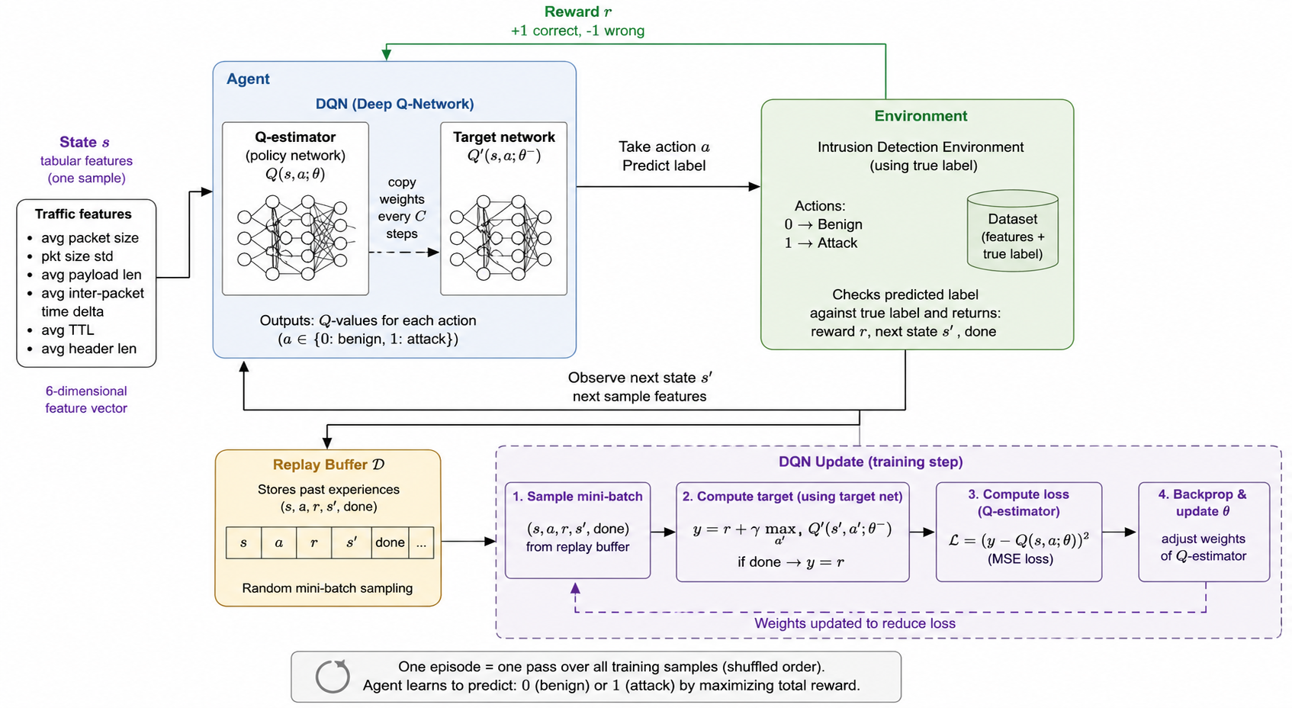
Reinforcement Learning
Attack detection formulated as a sequential decision problem using a Deep Q-Network (DQN) agent.
Agent learns to classify flows (benign vs. attack) through reward feedback (+1 correct, −1 incorrect).
Training shows steady improvement, with episodic reward increasing significantly over time.
Notes:
ACC= 0.96
Prec. = 98.98
Recall = 95.38
F1=97.14
MCC= 94%

Slide 9
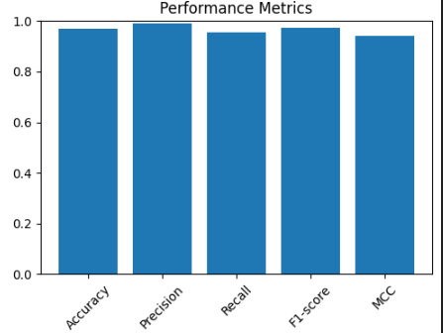
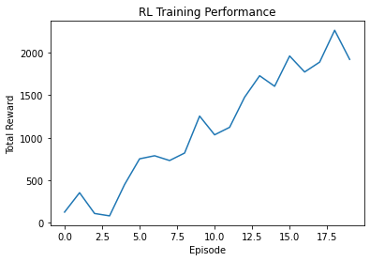
Reinforcement Learning
Attack detection formulated as a sequential decision problem using a Deep Q-Network (DQN) agent.
Agent learns to classify flows (benign vs. attack) through reward feedback (+1 correct, −1 incorrect).
Training shows steady improvement, with episodic reward increasing significantly over time.
Notes:
ACC= 0.96
Prec. = 98.98
Recall = 95.38
F1=97.14
MCC= 94%

Slide 10
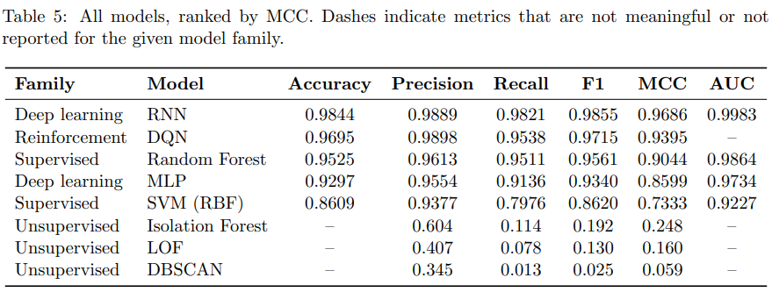
Summary of results
Ordered considering ML performance
Notes:
ACC= 0.96
Prec. = 98.98
Recall = 95.38
F1=97.14
MCC= 94%

Slide 11
Conclusion
Unsupervised methods significantly underperform compared to supervised models, highlighting the importance of labeled data for accurate CPS attack detection.
Random Forest emerges as a strong baseline, offering high accuracy with minimal preprocessing and tuning requirements.
The RNN achieves the best overall performance, demonstrating the value of capturing temporal patterns in network traffic.
Reinforcement learning (DQN) outperforms MLP using the same number of neurons.
Future work will focus on cross-dataset generalization, multimodal data fusion, and real-time deployment in CPS environments.

